Slide 1

Angular

Slide 2
Contents
Services
Dependency Injection
Hierarchical Dependency Injection
Dependency Resolution
Routing in Angular
Observables
Operators
Subjects
Forms in Angular

Slide 3

Services and Dependency Injection

Slide 4
Need of Services
Data source
Cross Component Communication

Slide 5
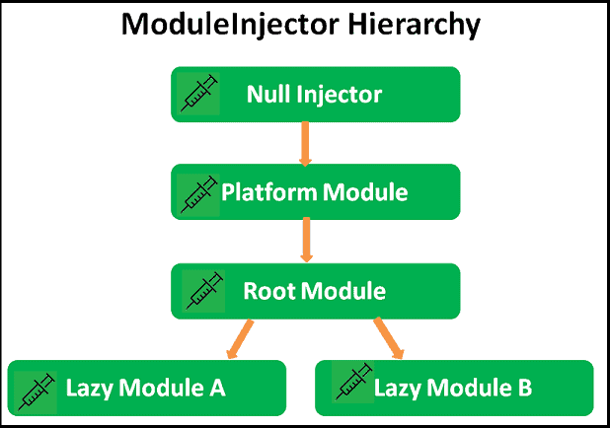
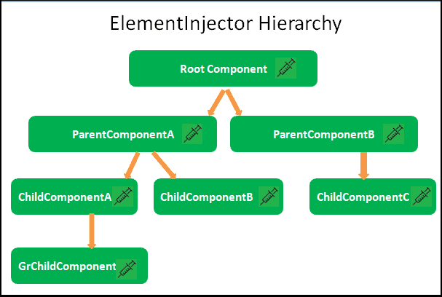
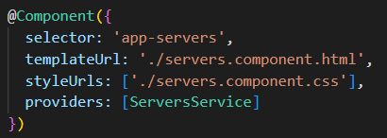

Hierarchical Dependency Injection

Slide 6
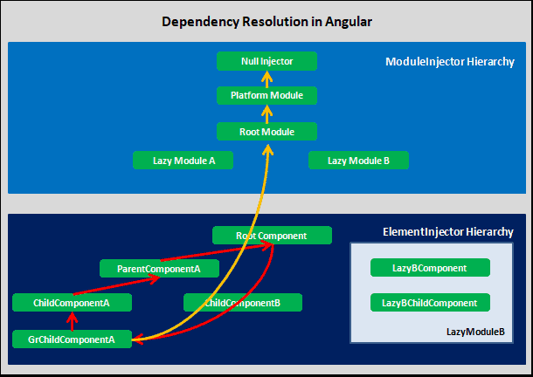
Dependency Resolution

Slide 7
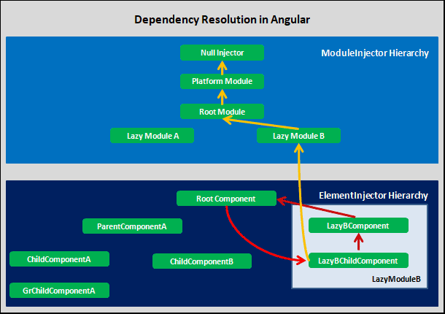
Dependency Resolution

Slide 8
Routing in Angular

Slide 9
RouterModule
Adds directives and providers for in-app navigation among views
Static methods
forRoot
forChild
Directives
RouterLink
RouterLinkActive
RouterOutlet

Slide 10
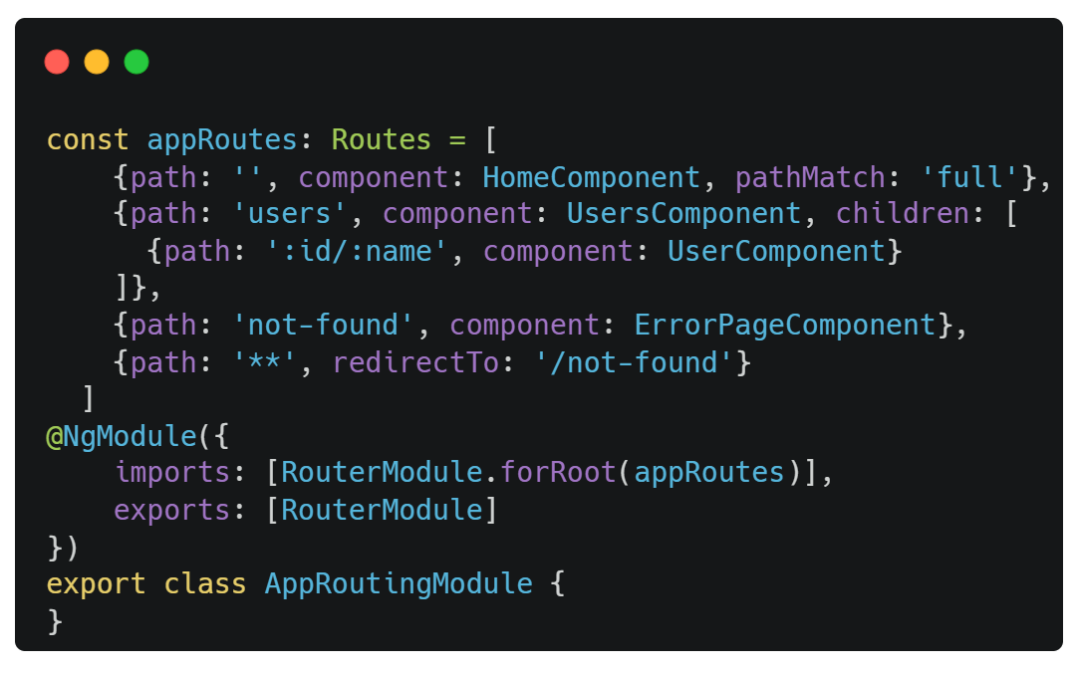
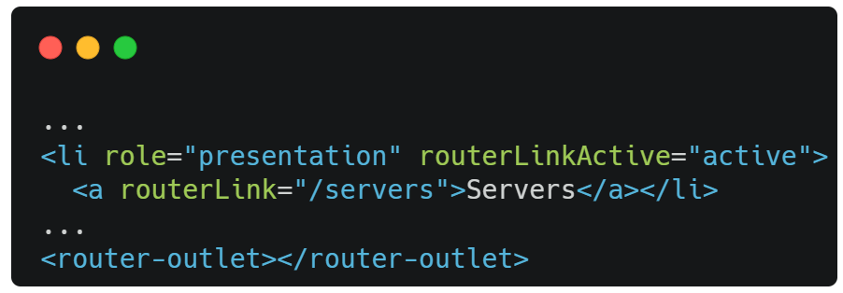
Setting up Routes

Slide 11
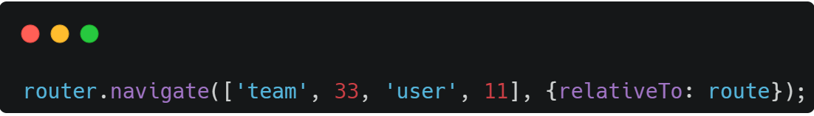
Navigating Programmatically
Router
A service that provides navigation among views and URL manipulation capabilities.

Slide 12
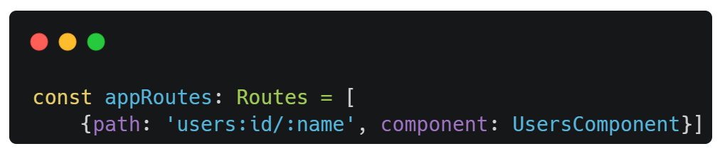
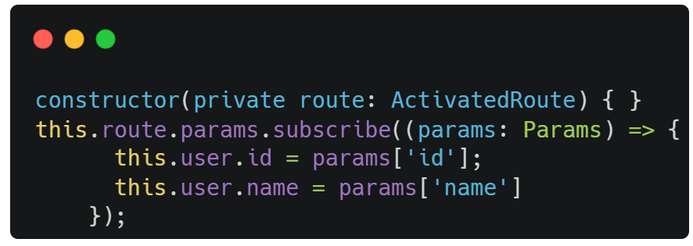
Passing and Fetching Parameters

Slide 13
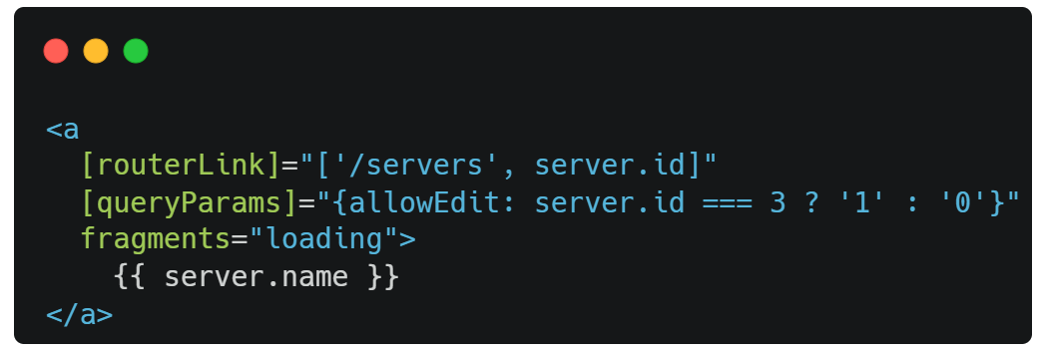
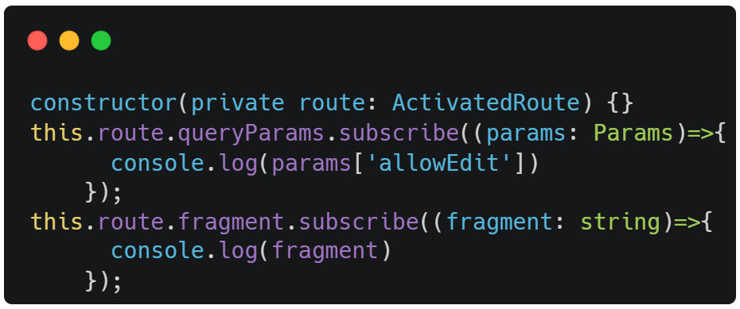
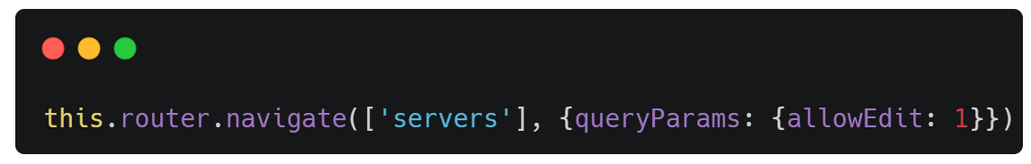
Query Parameters and Fragments

Slide 14
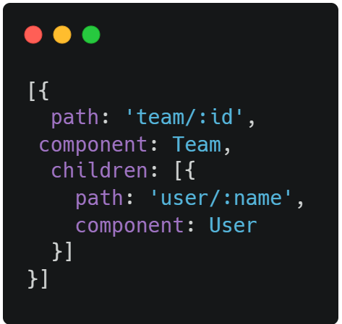
Child Routes
Navigation path 👇
/team/11/user/bob

Slide 15
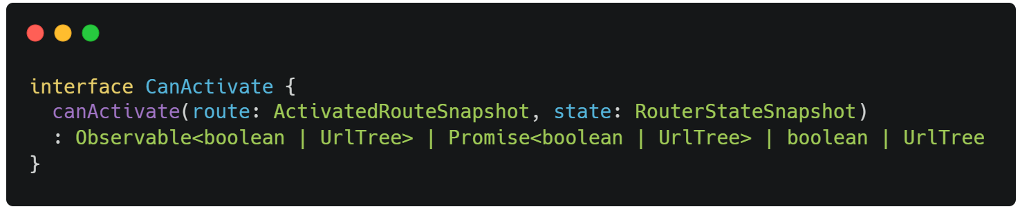
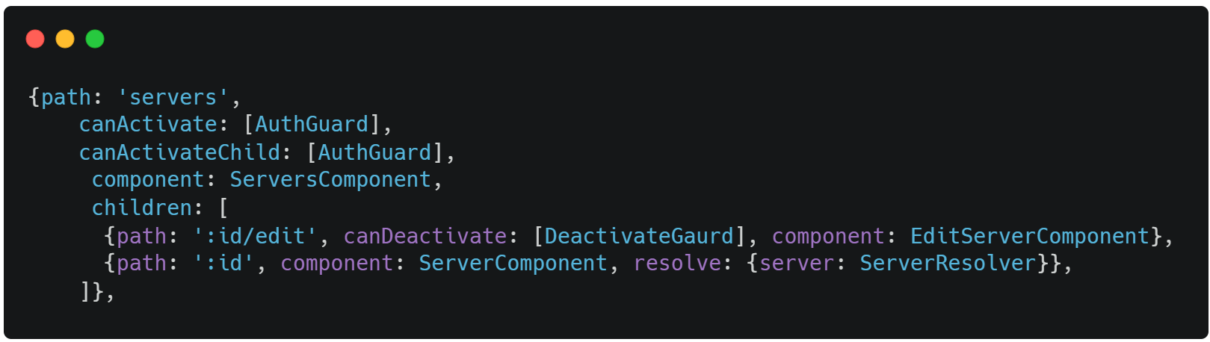
Guarding Routes
CanActivate
Guard deciding if a route can be activated.

Slide 16
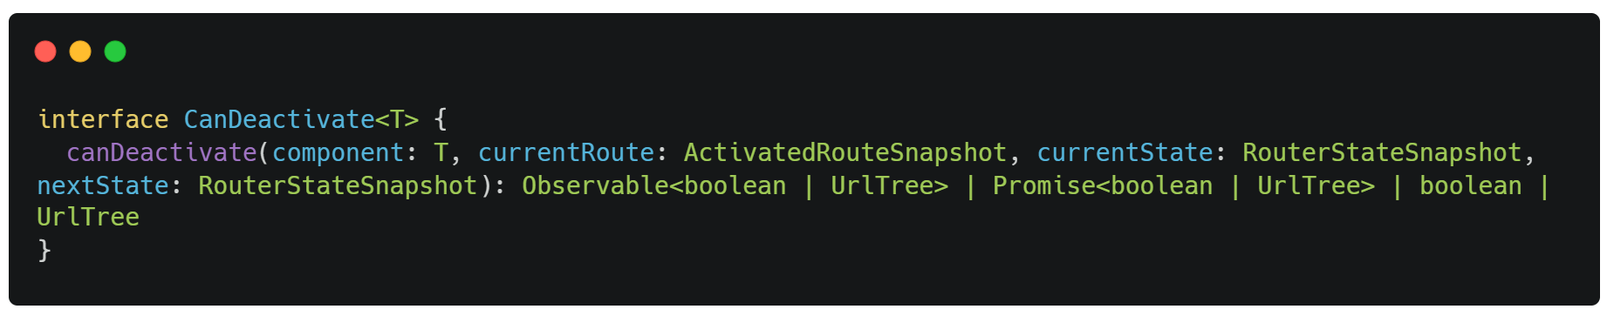
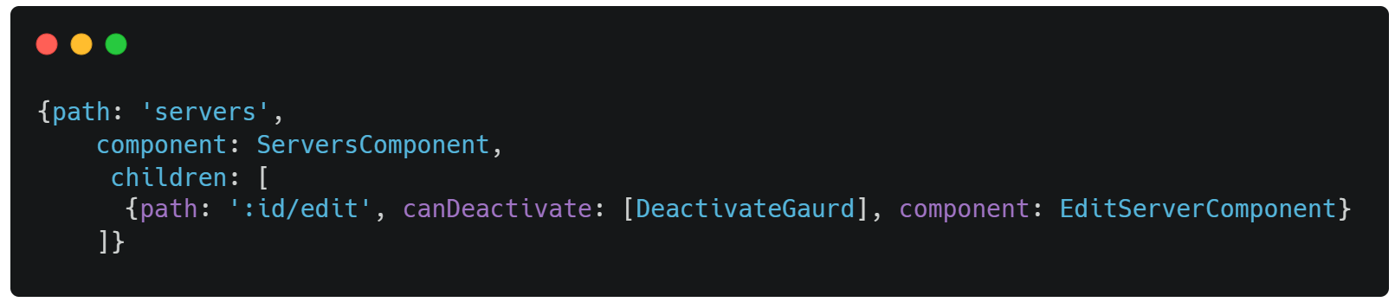
Guarding Routes
CanDeactivate
guard deciding if a route can be deactivated

Slide 17
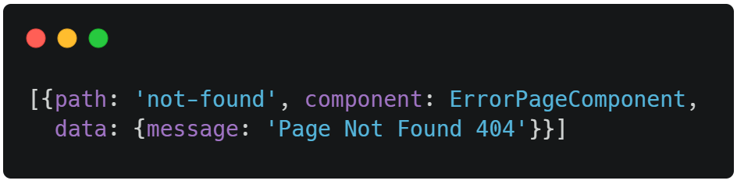
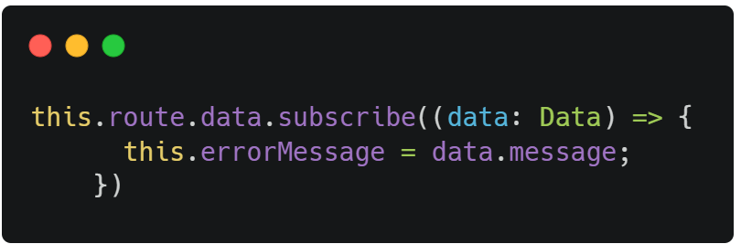
Passing Static Data

Slide 18
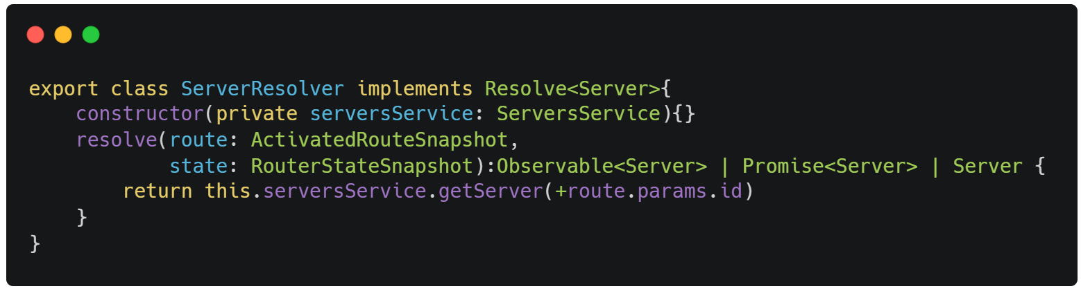
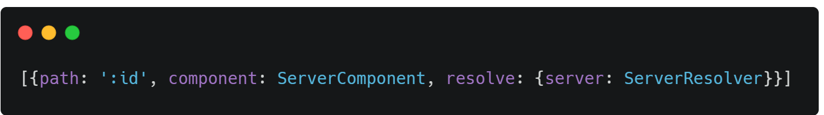
Data Resolvers
A data provider class can be used with the router to resolve data during navigation

Slide 19
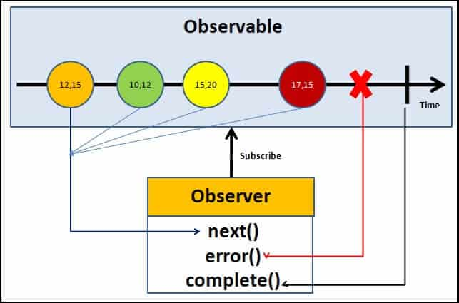
Observable
Observables are lazy Push collections of multiple values.

Slide 20
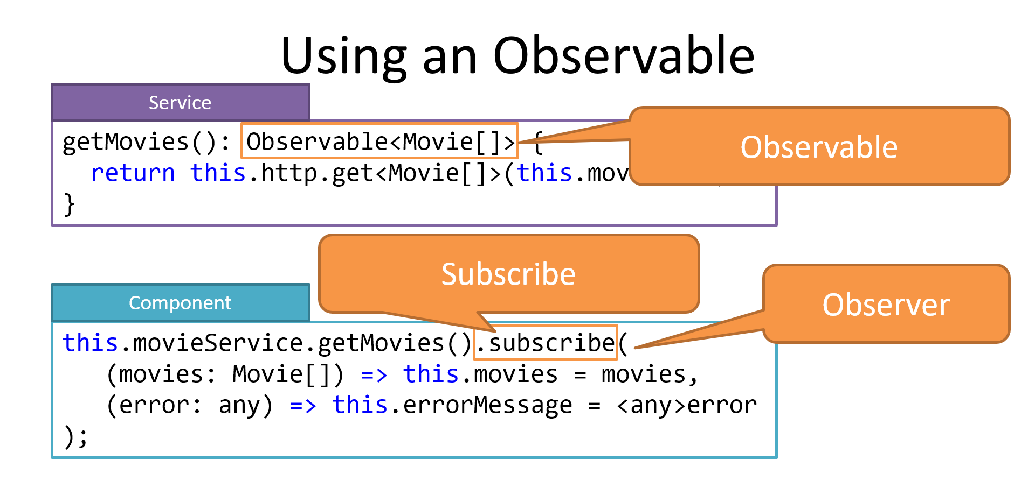
Using Observable

Slide 21
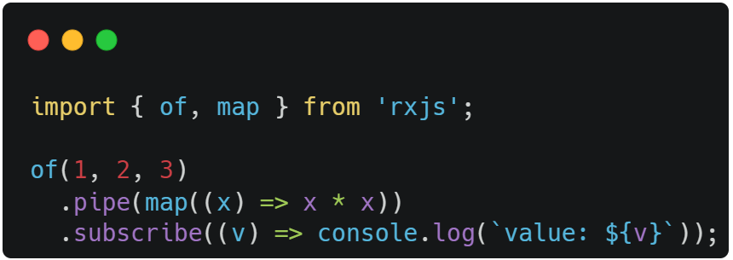
Operators
Pipeable Operators
Filter(), map()
Creation Operators
concatAll(), of()

Slide 22
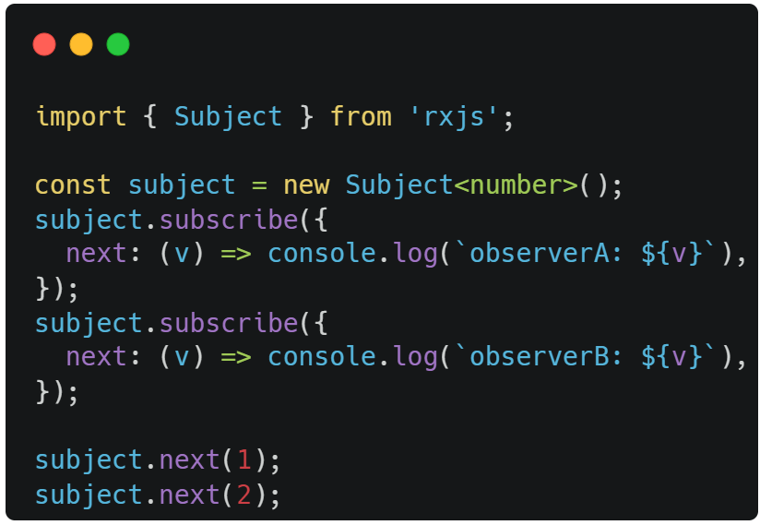
Subject
A Subject is like an Observable but can multicast to many Observers.

Slide 23

Forms in Angular

Slide 24
Template Driven Forms
TDF’s are configured in template
Use ngModel to create two-way data bindings for reading and writing input-control values

Slide 25
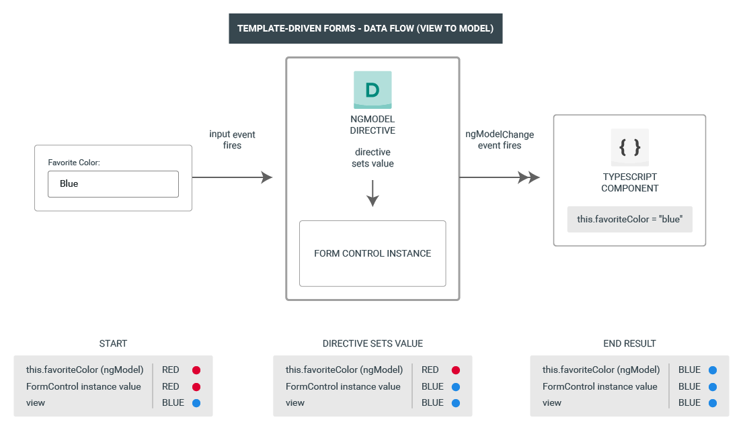
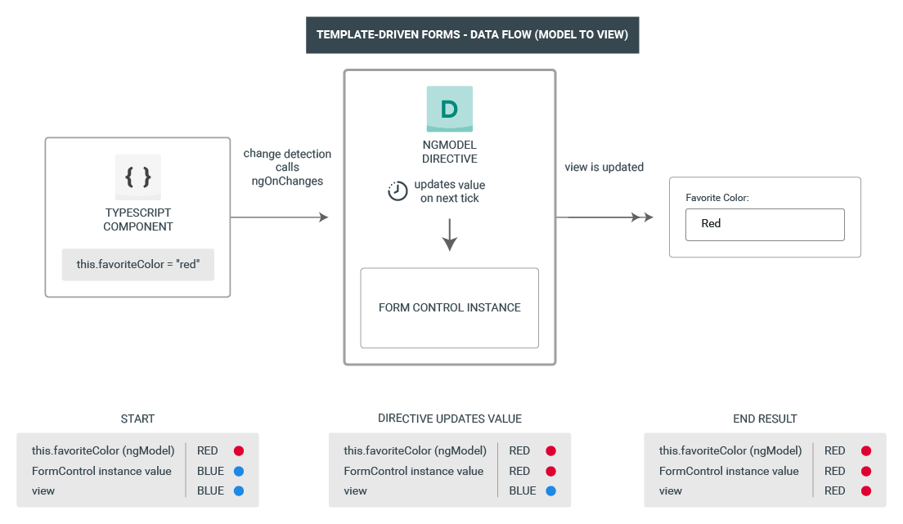

Slide 26
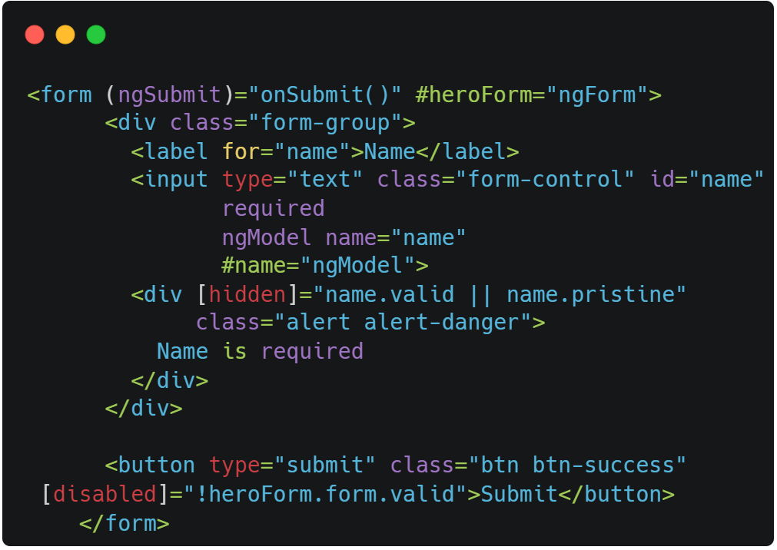
Form Creation

Slide 27
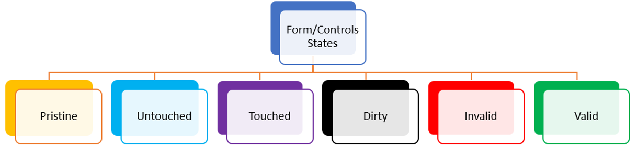
Form States

Slide 28
Form Validations
required
minlength
maxlength
pattern
email
supports in Ng4
min
max

Slide 29
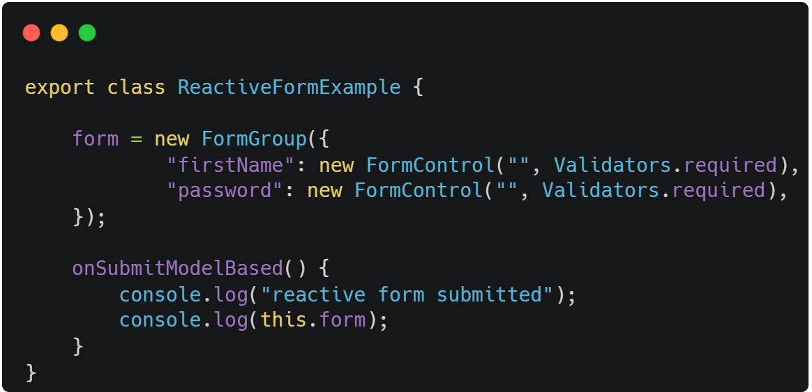
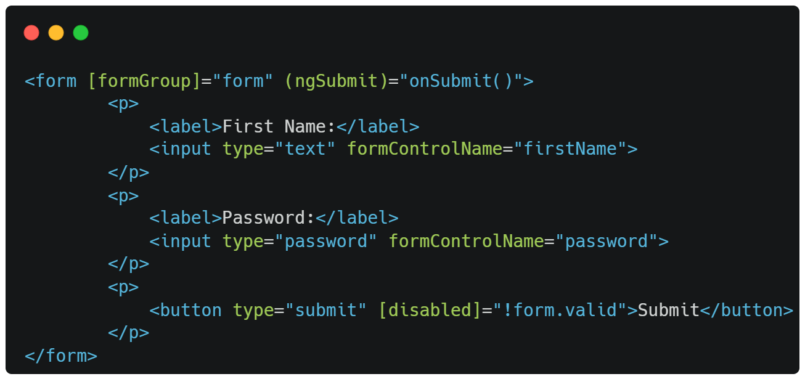
Reactive Forms
ReactiveFormsModule

Slide 30
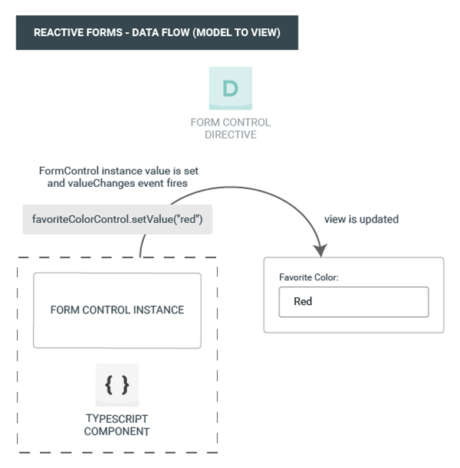
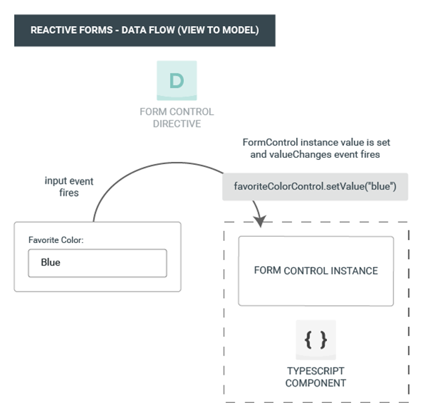

Slide 31
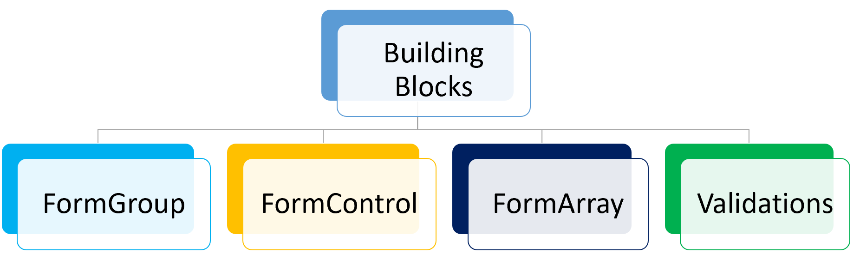

Slide 32
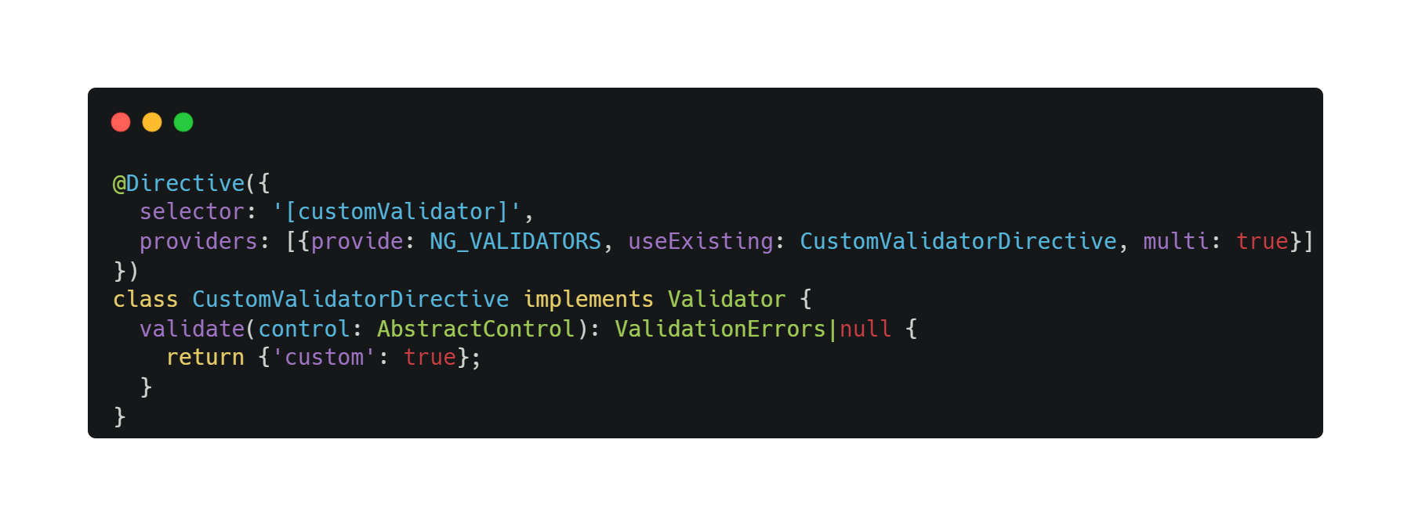
Custom Validators

Slide 33
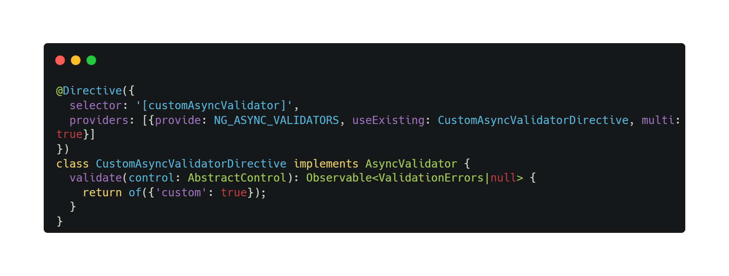
Asynchronous Validators

Slide 34

Thanks

